Slide 1
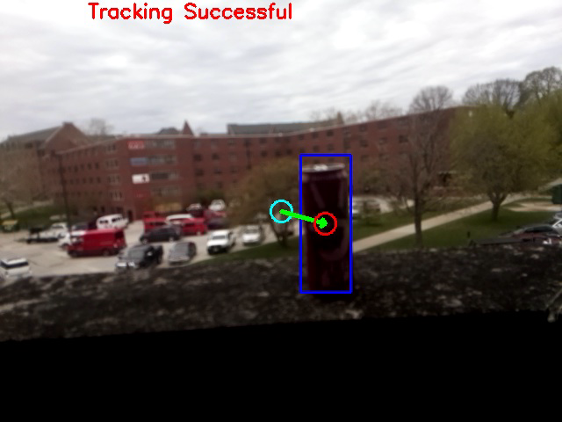
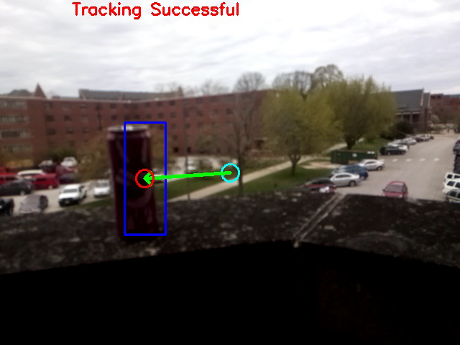
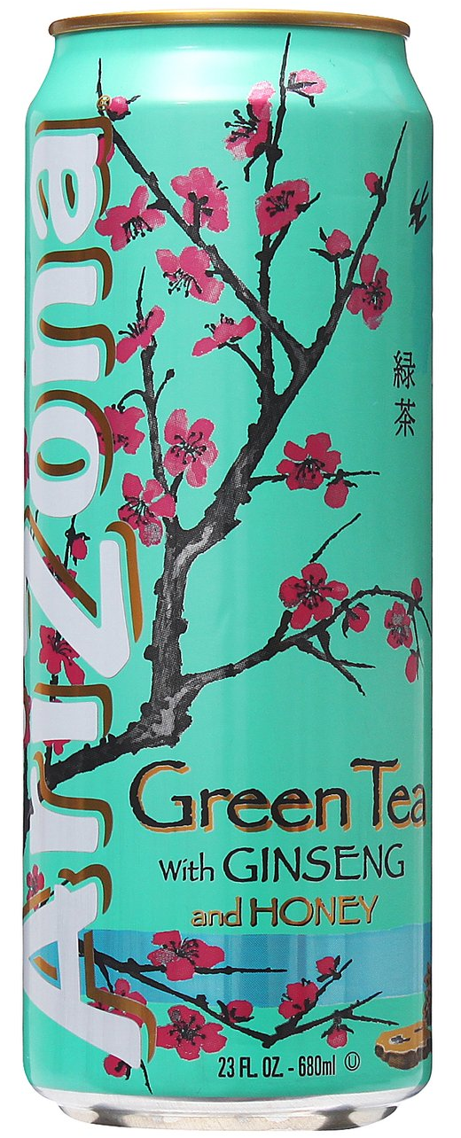

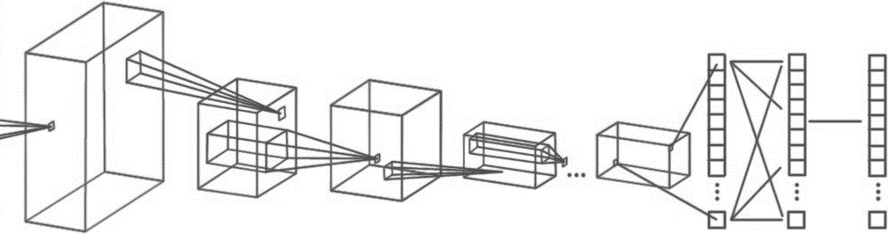
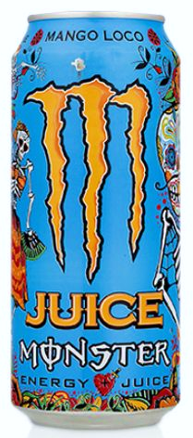
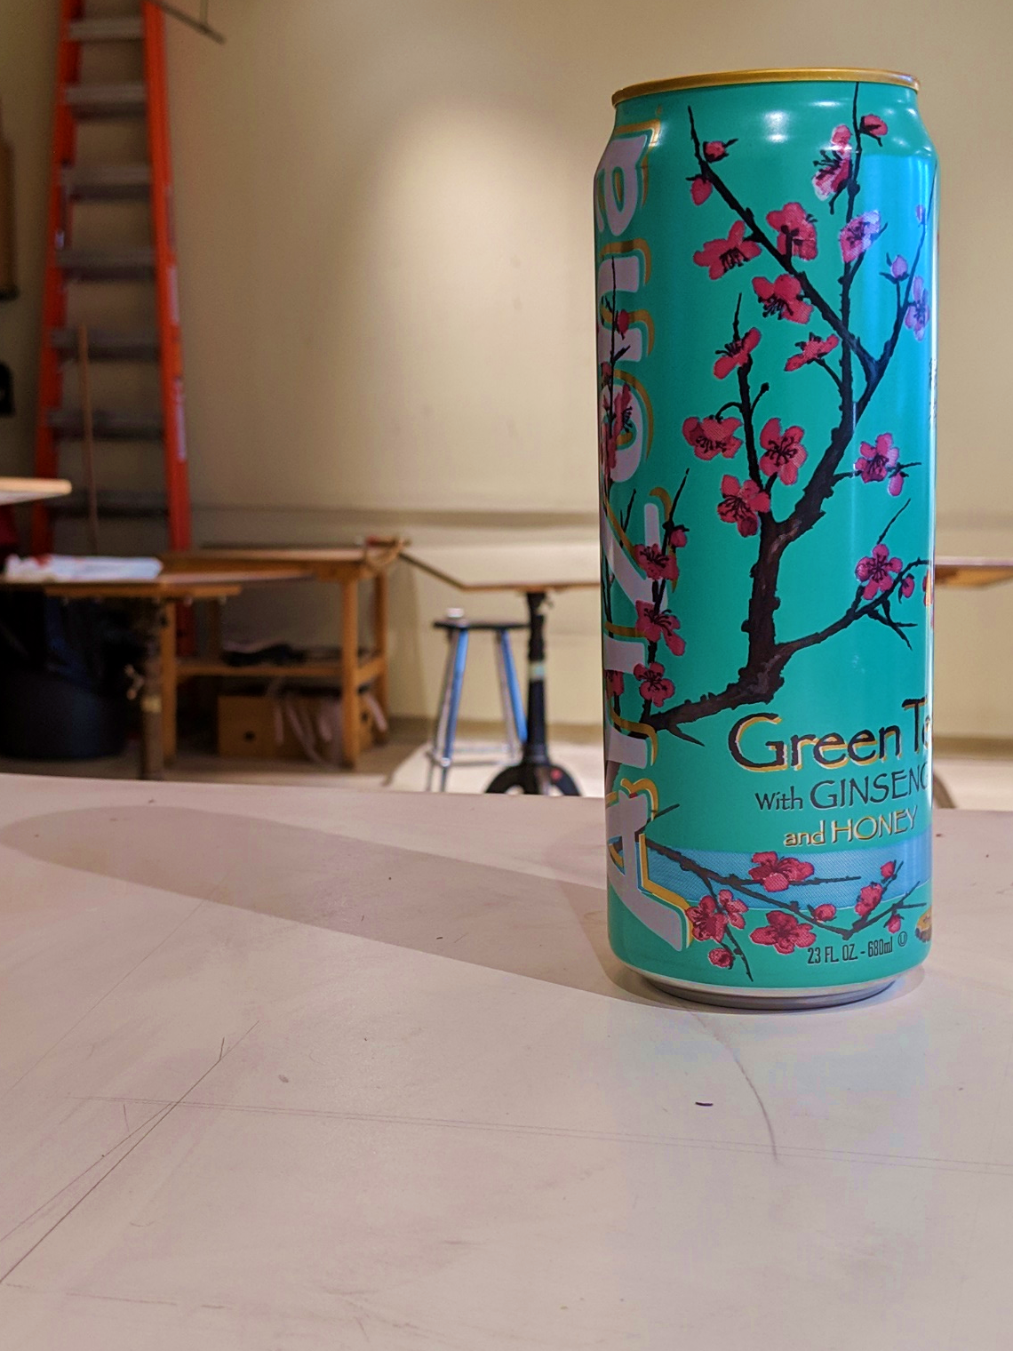
Computer Engineering 186
Spring 2019
Department of Electrical and Computer Engineering
Alexis J. Renderos, William Lavelle, Rolf Anderson, Ritvik Maripally
Adaptive Visual Target Identification and Tracking through
Convolutional Neural Network (CNN) based Machine Learning and Computer Vision
Abstract
The aim of this project is to identify a chosen object of interest at range using a camera feed and an image processing algorithm to assist in the detection, identification and tracking of the target. This solution was then implemented as a rail-mounted tactical scope attachment for a Nerf Blaster. The attachment provides the user with real-time feedback on their aim using a side mounted screen.
Target Tracking
Target tracking is accomplished using a hybridized algorithm known as KCF, or Kernelized Correlation Filters. We chose this algorithm due to its high speed, exceptional accuracy, and excellent failure detection. Unfortunately, KCF does not recover well from full occlusion, but the target tracking algorithm is able to recover from this using the target detection and identification capabilities of the machine learning model.
Conclusion and Analysis
Overall, the CNN based algorithm performed equally in comparison to the purely algorithmic solution. We found that the CNN algorithm had no trouble with identification but struggled heavily when faced with target occlusion. In contrast, the algorithmic solution excelled at recovering from occlusion, but struggled with target identification in extreme light conditions. We believe that with enough training data and training time/epochs that the CNN algorithm will overtake the success of the algorithmic solution.
Data Collection and Analysis
To properly analyze incoming image data, we must first determine and analyze key characteristics of our target. The three chosen targets (Fig. 1) were photographed over 1,000 times each in varying lighting conditions and at varying angles, distances, and varying degrees of occlusion. This provided us with a set of testing data and training data for our machine learning based target detection and identification algorithm. We also analyzed the colors and markings of the targets in addition to the angle of the target relative to the camera and the lighting conditions. This was later used to create an object tracking algorithm.
Hardware Implementation
As a proof of concept, we took our two algorithms and implemented them as a camera-based, rail mounted tactical scope attachment for a Nerf Blaster. The computational side is supported by a Raspberry Pi 3 connected to a camera, while power is sourced from the batteries inside the Nerf Blaster. Attached to the barrel of the blaster is an RGB light ring to help light up the target.
User Feedback
Mounted on the Nerf Blaster is a screen that displays the current camera feed to the user. A light blue reticule representing the center of where the blaster should shoot is displayed on-screen in white while the center of the target is highlighted on-screen with a bright red circle. Displayed from the center of the target to the center of the reticule is a green arrow indicating the error in aim. The user receives additional feedback on their aim with yellow markings.
Target Detection and Identification
Target detection and identification is primarily achieved through the implementation of a machine learning based algorithm. A Convolutional Neural Network (CNN) was trained on a dataset of nearly 3,000 photos of the three targets in order to create a comprehensive profile of what the targets looked in the eyes of a digital camera. The resulting model was then used to analyze incoming camera data to locate and identify any potential targets in its field of view.
Convolutional Neural Network Framework
(Fig. 2)
INPUT
CONVOLUTION + RELU POOLING
CONVOLUTION + RELU POOLING …
FLATTEN
FULLY
CONNECTED
SOFTMAX
Objects of Interest
(Fig. 1)
FEATURE LEARNING
CLASSIFICATION

